Slide 1
UNIT-III
Dummy modelling and Panel Data Model Dummy modeling 9 Hrs
• Dummy independent, modelling-linear probability Model-Logit model-Probit model Mental and neurological disorders
• Panel Data Model: Concept - Panel Data Models - Fixed Effects Model - Random Effects
Model - Forms of Panel Data Models - Applications to use Panel Data Models.

Slide 2
Econometric Modeling for Binary Outcomes
When your dependent variable Y is binary (e.g., 1 = Has a neurological disorder, 0 = Does not have a neurological disorder), standard linear regression has limitations. Economists and data scientists use specific models to handle this.
Dummy Independent Variable:
Dummy Variables is a categorical
variable converted into a numerical form, usually 0 and 1, so that it can be included in a regression model. It represents the presence or absence of a characteristic.
Category | Dummy Values
Yes | 1
No | 0

Slide 3
These are the qualitative variables turned into numerical proxies 0 or 1 to capture categories (e.g., Gender: Female = 1, Male = 0; Location: Urban = 1, Rural = 0).
They shift the intercept of your regression line up or down based on the group, allowing you to control for categorical risk factors.
Example:1 = Attended coaching, 0 = Did not attend coaching. A regression model cannot directly calculate something like:
Y = β₀+β₁ D + ϵ , because “Yes” and “No” are not numerical values.

Slide 4
Because regression equations require numerical inputs, but categorical information is often expressed as words or categories.
Example: Suppose we want to predict student marks based on whether a student attended a special coaching program. We cannot directly put "Yes" and "No" into a regression equation, so we represent them as 1 and 0.
Student | Coaching ? | Dummy Values
A | Yes | 1
B | No | 0
C | Yes | 1
D | No | 0
Dummy variables convert qualitative / categorical information into numerical information so that regression can estimate its effect on the dependent variable.

Slide 5
How is it used in regression?
Suppose the estimated regression equation is:
Marks=60+8D Here, D is the coaching dummy variable.
D = 0, No coaching, Marks=60+8(0)=60
D = 1, Coaching attended, Marks=60+8(1)=68.
Interpretation: The estimated marks are 8 points higher for students who attended coaching than for those who did not.
This is an association in the model; it does not, by itself, prove that coaching caused the improvement.

Slide 6
For the model: Y = β0+β1 D + ϵ
β0: expected value of Y for the reference group D=0.
β1: difference in expected Y between the group coded 1 and the reference group.
This interpretation assumes there are no additional predictors in the model. With other predictors included, the difference is interpreted while holding them constant.

Slide 7
Multiple Categories (Multiple Independence):
For k categories, generally use k-1 dummy variables when including an intercept.
Select one category as the reference group.
Coefficients compare each represented category with the reference group.
Using all k dummy variables along with an intercept creates the dummy variable trap.

Slide 8
Modelling Nonlinear Probability Model:
A nonlinear probability model is used when the dependent variable represents a binary outcome, such as Yes/No, Pass/Fail or Disease/No Disease and we want to estimate the probability of an event occurring. Nonlinear probability models estimate the probability of a categorical outcome rather than predicting a continuous numerical value. For example, we want to predict whether a student will pass an examination based on study hours. Pass = 1, Fail = 0.
The objective is to estimate: P(Y=1 | X)
This means the probability that a student passes, given the number of study hours.

Slide 9
Why do we need it?
Linear regression can produce predictions below 0 or above 1 when used directly for probabilities.
Probability models constrain estimated probabilities to the interval [0,1].
They can represent nonlinear relationships between predictors and probability.
Common models: Logit and Probit.
Suppose we use an ordinary linear regression model to predict the probability of passing: P(Y=1) = β0+ β1 X

Slide 10
It may predict probabilities such as -0.2 or 1.3. But a probability must always lie between 0 and 1. Therefore, we use models such as Logit and Probit, which transform the model output into a valid probability.
Example: Predicting Student Pass Probability:
Imagine a model estimates the probability of passing based on study hours. The probability generally increases with study hours in this ex. The model does not simply predict marks; it estimates the likelihood of a binary outcome.
Study hours | Estimated probability of passing
1 | 0.15 (15%)
3 | 0.40 (40%)
5 | 0.70 (70%)
8 | 0.95 (95%)

Slide 11
Applications:
Student pass/fail prediction
Customer purchase prediction
Loan default prediction
Disease occurrence prediction
Employee attrition prediction

Slide 12
Linear Probability Model (LPM)
An Ordinary Least Squares (OLS) regression used where the dependent variable is a dummy 0 or 1.
Equation: Y = β₀+β₁ X + ϵ
Pros: Highly intuitive; the coefficients directly tell you the change in probability.
Cons:
  Can predict nonsensical probabilities (e.g., greater than 100% or less than 0%).
  Suffers from inherent heteroskedasticity (unstable error variance).

Slide 13
Logit Model:also called Logistic Regression, is a statistical model used to estimate the probability of an event when the dependent variable is binary.
The dependent variable has two possible outcomes, generally coded as:Y=1: Event occurs, Y=0: Event does not occur.
Example: Predict whether a student will pass or fail based on study hours. Pass = 1, Fail = 0.The model estimates the probability of passing, rather than directly predicting marks.Ordinary linear regression might produce probabilities such as -0.2 or 1.3. These are invalid because probability must lie between 0 and 1.

Slide 14
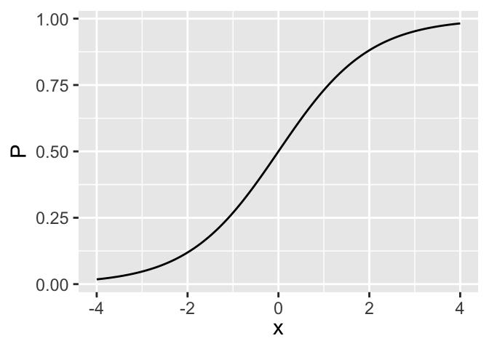

The Logit Model uses a logistic function to ensure that the predicted probability remains within this range. The logistic function produces an S-shaped curve:
At low values of X, probability
may be low.
In the middle region, probability can increase rapidly.
At high values of X, probability approaches 1.
It approaches 0 and 1 but does not reach either exactly for finite values of the input.

Slide 15
Logit transformation:
The Logit Model can also be written in terms of odds and the log-odds.First, calculate the odds: odds= p/(1-p)
Then take the natural logarithm: Log (p/1-p)= β₀+β₁ X.
p = probability that the event occurs
1-p = probability that it does not occur
p/1-p = odds of the event
The logit transformation allows the model to relate predictors linearly to the log-odds while keeping predicted probabilities between 0 and 1.

Slide 16

Logistic Function:
Converts the linear predictor into a probability.
Predicted probabilities lie between 0 and 1.
The resulting relationship is S-shaped.
Logit Transformation:
Odds = p/(1-p)
Log-odds = natural logarithm of odds
Predictors are related linearly to the log-odds.

Slide 17
For example: Student passes → 1, Student fails → 0.We want to predict: What is the probability that a student will pass based on the number of hours studied? Suppose we collect data from students: Logistic Regression model learns the relationship between study hours and the pass/fail outcome. Suppose the model produces these illustrative predictions:
Study Hours | Actual result
1 hr | Fail (0)
3 hrs. | Fail (0)
5 Hrs. | Pass(1)
8 Hrs. | Pass(1)
the model predicts a probability, not the actual result with certainty. For example, a 70% probability means the model estimates that a student with those characte ristics has a 70% chance of passing, according to the fitted model. p=(1/1+ e-z) where, z= Y = β₀+β₁ X.

Slide 18
How does probability become Pass or Fail?
The model initially gives a probability. We can then choose a decision threshold. Suppose we use 50% as the threshold:
30% Predicted Fail Probability is below 50%.
70% Predicted Pass Probability is at least 50%.
The 50% threshold is a choice, not a fixed rule. In real applications, the best threshold depends on the consequences of false predictions.
What makes it a “Logit” model?
The model can also express the relationship using log-odds:
log(P/ 1- P) =β₀+β₁ X Here, p is the probability of passing.

Slide 19
In simple terms,
the Logit Model relates the predictors to the log of the odds of the event occurring. This is how it models probabilities without allowing them to go below 0 or above 1.
Summary:
Used when the dependent variable is binary (0 or 1).
Estimates the probability of an event.
Uses the logistic function to keep probabilities between 0 and 1.
A threshold can convert the probability into a predicted category.
Applications include pass/fail prediction, loan default, customer purchase and disease occurrence.

Slide 20
Logit Model (Summary):
A non-linear model that uses a logistic cumulative distribution function (CDF) to ensure predicted probabilities stay strictly between 0 and 1.
It models the log-odds of an event occurring.
Coefficients are interpreted using Odds Ratios rather than direct probabilities.

Slide 21
A Probit Model: is a statistical model used to estimate the probability of an event when the dependent variable has two possible outcomes. For ex, we want to predict whether a student will pass an examination based on study hours. Pass = 1 Fail = 0. Our objective is to estimate the probability that a student will pass. P (Y=1 | X). Here: Y = examination result (Pass or Fail), X = study hours, P(Y=1 | X) = probability of passing given the study hours X. The Probit Model uses a Gaussian (bell curve) CDF to bound the probabilities between 0 and 1. Similar to Logit, but assumes the underlying unobservable utility or risk follows a standard normal distribution.

Slide 22
Need: Suppose we use ordinary linear regression to predict whether a student passes or fails, coding Pass as 1 and Fail as 0. A linear model might predict:
0.3 → can be interpreted as a 30% predicted probability in a linear probability model.
1.2 → invalid as a probability because it exceeds 1.
− 0.2 → invalid as a probability because it is below 0.
A linear probability model can therefore produce predictions outside the valid probability range. The Probit Model addresses this problem by using the cumulative distribution function of the standard normal distribution to convert the model's output into a probability between 0 and 1.

Slide 23
Working: study hours may influence a student's likelihood of passing, but passing also depends on other factors, such as preparation, understanding, and examination difficulty.
The Probit Model estimates the probability of passing based on the available predictors.
Its basic equation is:
Where:
P(Y=1 | X) = probability of passing, X = study hours
β₀ = intercept, β₁ = coefficient for study hours
Ф = cumulative distribution function (CDF) of the standard normal distribution
The important term is Ф. It converts the calculated value into a probability between 0 and 1.

Slide 24
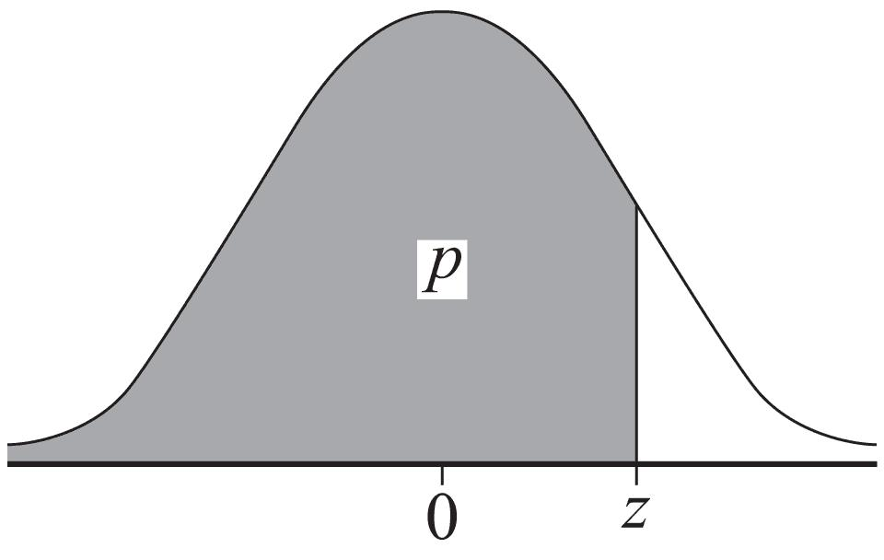
The standard normal distribution is a bell-shaped proba. distrib. with: Mean = 0, Standard deviation = 1.The CDF, shown by Ф(z), tells us the area under the bell curve to the left of a particular value z.
Value of z | Ф(z)
-1 | Approximately 0.159
0 | 0.500
1 | Approximately 0.841
2 | Approximately 0.977
So, if the linear predictor is z=1, the Probit Model estimates a probability of approximately 84.1%.You do not need to calculate the area manually. Software such as Python can calculate it.

Slide 25
Example: Predicting student pass probability
Suppose our fitted Probit Model: P(Pass=1 | X)= Ф (-2+0.5X)
Here, X is the number of study hours.
To calculate the linear predictor For a student studying 4 hours: z= -2 + 0.5(4)=0.
Apply the standard normal CDF : P(Pass=1 | X=4)=Ф(0)
From the standard normal distribution: Ф(0)=0.50
Therefore, the estimated probability of passing is 50%.
Logit & Probit yield very similar results. Logit has slightly flatter tails, while Probit is preferred if you assume the underlying real-world traits are normally distributed.

Slide 26
Feature | Logit Model | Probit Model
Functional Form | Non-linear (Logistic CDF) | Non-linear (Normal CDF)
Probability Bounds | Strictly bounded between 0 and 1 | Strictly bounded between 0 and 1
Interpretation | Requires Odds Ratios | Requires calculating marginal effects
Error Distribution | Logistic distribution | Standard Normal distribution

Slide 27
Mental and Neurological Disorders: In healthcare, it can help researchers study the relationship between patient characteristics and the likelihood of a condition.
Examples include: Estimating the risk of depression using questionnaire responses, Studying factors associated with neurological disorders, Predicting the likelihood of hospital readmission, Identifying patterns in patient data
These models support research and clinical decision-making; they do not replace diagnosis by qualified healthcare professionals.

Slide 28
How can the Logit and Probit models be used?
Suppose researchers want to study whether certain factors are associated with a medical condition.The dependent variable could be coded as: Y=1: Condition present, Y=0: Condition absent.
Predictors might include age, sleep duration, lifestyle variables, or questionnaire scores, depending on the research question and available data. The model estimates the probability of the specified outcome given the predictors. A Probit Model serves a similar purpose but uses the standard normal cumulative distribution function instead.

Slide 29
A logistic regression model could estimate how these variables are associated with the probability of meeting that screening threshold. Researchers can study associations between patient characteristics and outcomes.Predictions should be validated and interpreted responsibly.
Limitations and Ethical Considerations:
Protect patient privacy and confidentiality.
Check data quality and model performance.
Avoid biased predictions caused by unrepresentative data.
Distinguish statistical association from causation.
Do not use a model's prediction as a substitute for professional diagnosis.

Slide 30
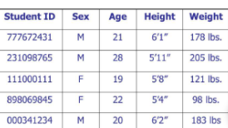
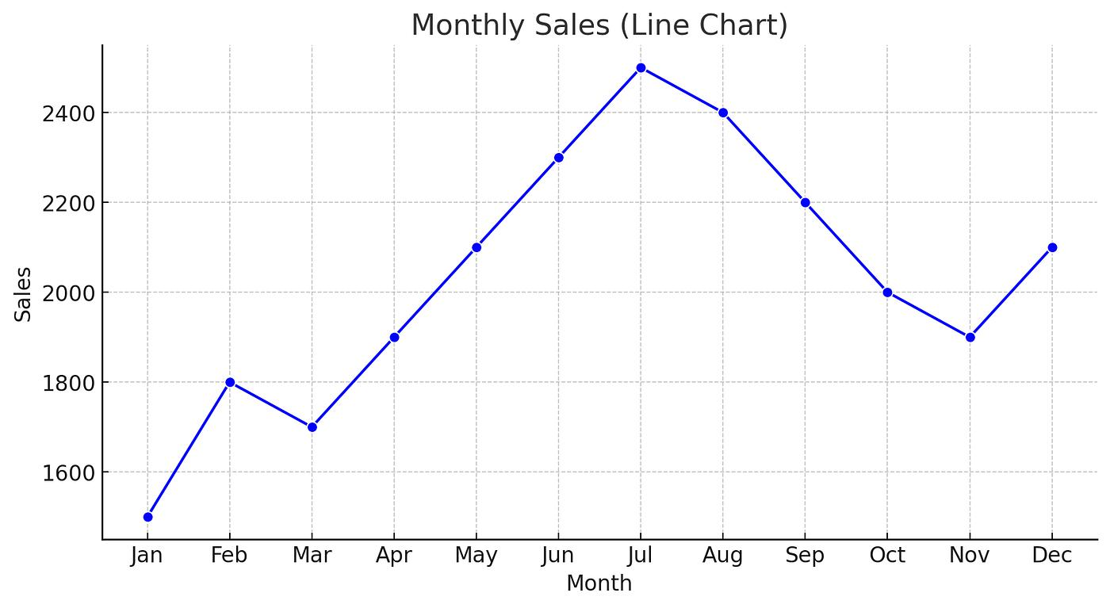
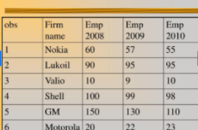
Types of Data
A. Cross-sectional data:
Data collected from different entities at one point in time.Ex. Marks of 100 students in Semester 1.
B. Time-series data:
Data collected for one entity over multiple time periods. Ex. Monthly sales of one shop over 12 mts.
C. Panel data:
Data collected for multiple entities over multiple time periods. Ex. Monthly sales of 10 shops over 12 mts.

Slide 31
Features | Cross Sectional | Time Series | Panel Data
Entities | Many | One | Many
Time Period | One | Many | Many
Example | 100 students in one semester | One student's marks across semesters | Many students across semesters
Panel Data Model?
Panel data is a dataset that observes the same individuals, organizations or other entities over multiple time periods. A Panel Data Model is a statistical model used to analyze this data, helping us understand how outcomes change over time and how they differ between entities.

Slide 32
Structure of a Panel Data Model: A simple panel regression model can be represented as: Y_{it}=β₀+β₁X_{it} + ∝_{i}+Ɛ_{it} Where:
Y_{it}: outcome for entity i at time t, such as student marks.
X_{it}: predictor for entity i at time t, such as study hours.
β₀: intercept.
β₁: estimated relationship between the predictor and outcome.
∝_{i}: entity-specific effect, such as a student's relatively stable characteristics. The entity-specific effect ∝_{i} helps us account for characteristics that differ between students but remain relatively stable over time.
Ɛ_{it}: Error Term.

Slide 33
In the Panel Data model : Y_{it}=β₀+β₁X_{it} + ∝_{i}+Ɛ_{it}
The entity-specific effect ∝_{i} represents the unique, time-invariant characteristics of a specific cross-sectional unit (such as a person, firm, state, or country) that do not change over time helps us account for characteristics that differ between students but remain relatively stable over time. These effects absorb all unobserved factors that are constant over time for a given entity, such as:
For firms: Corporate culture, management quality, brand equity or initial location.
For countries: Historical background, institutional structure, geography or baseline political systems.
For individuals: Innate ability, background or long-term preferences.

Slide 34
Fixed Effects and Random Effects models handle these effects differently.
Why Do We Use Panel Data Models?
Study changes over time: Examine how student marks change across semesters.
Compare entities: Compare students, colleges, hospitals, companies or countries.
Account for individual differences: Some students may perform better consistently for reasons not fully captured by study hours.
Use more information: Combining entities and time periods can provide richer information than using only one cross-section.
Support decisions: Colleges can identify performance trends and evaluate whether interventions are associated with improvement.

Slide 35
Types of Panel Data Model:
Models handle these effects differently.
Fixed Effects (FE) Model ("Within" Model)
Random Effects (RE) Model
Fixed Effects Model?
A Fixed Effects Model (FEM) is a panel data model that accounts for differences between entities that remain constant over time. These differences may include a student's natural ability, a company's mgmt. culture or a hospital's permanent infrastructure characteristics.
Example: Suppose we want to study whether additional study hours improve students' marks over three semesters. Some students may consistently score higher because of their existing abilities.

Slide 36
A Fixed Effects Model accounts for these stable differences when estimating the relationship between study hours and marks.
Both students improve as their study hours increase, but Student B consistently scores 10 marks more than Student A. A basic regression might overlook stable differences between the students. Fixed Effects accounts for those student-specific differences.
Student | Sem | Study hours/week | Marks
A | 1 | 4 | 60
A | 2 | 6 | 70
A | 3 | 8 | 80
B | 1 | 4 | 70
B | 2 | 6 | 80
B | 3 | 8 | 90
The goal is to estimate the relationship between study hours and marks while controlling for characteristics that do not change over time.

Slide 37
Mathematical model
The Fixed Effects Model can be represented as:
Y_{it}= ∝_{i} + β X_{it} + Ɛ_{it} Where:
Y_{it}: outcome for entity i at time t, such as marks.
X_{it}: predictor, such as study hours.
∝_{i}: entity-specific intercept.
β: estimated effect of the predictor.
Ɛ_{it}: error term.
Each entity can have its own intercept, but the model commonly estimates a shared slope β.

Slide 38
Example: Studying the relationship between weekly study hours and student marks across multiple semesters while controlling for stable differences between students.
Working:
Collect panel data for multiple students across semesters
Identify stable differences between students
Control for student-specific effects
Estimate how changes in study hours relate to changes in marks
One common estimation method is the within transformation. It subtracts each student's average values from their observations, removing stable student-specific effects.

Slide 39
Advantages | Limitations
Controls for stable entity-specific differences | Can’t estimate the separate effects of characteristics that never change within an entity
Useful for tracking entities over time | Requires repeated observations
Helps reduce bias from omitted, time-invariant characteristics | Does not automatically remove bias from time-varying omitted variables

Slide 40
Random Effects Model:
A Random Effects Model is a panel data model that accounts for differences between entities by treating those differences as random effects.
In simple words, different companies, colleges, hospitals, or stores may have different characteristics. The Random Effects Model accounts for these differences by assuming they are random and uncorrelated with the explanatory variables.
is a statistical approach where group- or subject-specific effects are treated as random variables drawn from a larger population. Unlike fixed effects models, it assumes unobserved individual or study differences are uncorrelated with your independent variables and accounts for both within-group and between-group variance.

Slide 41
Example: Suppose we study the relationship between advertising expenditure and sales for 10 stores over 5 years. Some stores may naturally have better locations or more loyal customers. The Random Effects Model accounts for such store-specific differences.
Mathematical model: Y_{it}= β₀ + β₁ X_{it} + μ_{i}+Ɛ_{it} Where:
Y_{it}: outcome for entity i at time t
X_{it}: explanatory variable
β₀: common intercept
β₁: effect of the explanatory variable
μ_{i}: entity-specific random effect
Ɛ_{it}: remaining error.

Slide 42
Basis | Fixed Effects (FEM) | Random Effects (REM)
Entity differences | Allows entity-specific intercepts | Models entity differences as random effects
Main assumption | Entity effects may correlate with predictors | Entity effects are uncorrelated with predictors
Time-invariant variables | Their separate effects cannot generally be estimated | Their effects may be estimated if the model assumptions hold
Typical application | Controlling for stable differences between entities | Estimating effects while accounting for entity-level variation
Estimation | Within transformation or entity indicators | Variance-components-based estimation

Slide 43
Key Diagnostic Tests
Breusch-Pagan Test: Compares a random effects model against a simple Pooled OLS (Ordinary Least Squares) model to see if variance across groups is significant.
Hausman Test: Compares random effects against fixed effects to check whether the unobserved individual effects are correlated with the predictors.
Intraclass Correlation Coefficient (ICC): Measures how much of the total variance is explained by the group-level random effect. A high ICC means data points within the same group cluster tightly together.

Slide 44
How do we choose between FEM and REM?
A commonly used method is the Hausman Test.
H₀: Random Effects is consistent and appropriate under the model assumptions.
H₁: Random Effects is inconsistent; Fixed Effects is preferred.
At the 5% significance level:
If (p < 0.05): Reject H₀; generally prefer Fixed Effects.
If \(p > 0.05): Do not reject H₁; Random Effects may be appropriate.
A large p-value does not prove that Random Effects is correct; the assumptions and study design still matter.

Slide 45
Applications:
Panel Data (Econometrics & Social Science): Analyzes repeated observations on the same individuals, firms, or countries over time while handling group-level noise.
Meta-Analysis: Combines multiple independent studies that estimate varying true effect sizes due to real clinical or methodological heterogeneity.
Hierarchical / Multilevel Data: Models nested structures, such as students grouped inside classrooms or patients grouped inside hospitals.

Slide 46
Application | Entity | Time dimension | Example outcome
Education | Colleges | Academic years | Student pass percentage
Business | Retail stores | Months | Sales
Banking | Banks | Years | Profit
Healthcare | Hospitals | Months or years | Patient outcomes
Economics | States | Years | State GDP
Summary:
Fixed Effects: Each entity can have its own fixed baseline.
Random Effects: Entity-specific differences are treated as random variation.

Slide 47
Forms of Panel Data Models
1. What are the forms of panel data models?
Panel data combines observations on multiple entities over multiple time periods. The main model forms we have discussed are:
Pooled Ordinary Least Squares (Pooled OLS)
Fixed Effects Model (FEM)
Random Effects Model (REM)

Slide 48
Suppose we want to study the effect of advertising expenditure on sales for five retail stores over three years.
Dependent variable Y: Sales
Independent variable X: Advertising expenditure
Entity: Retail store
Time dimension: Year

Slide 49
Pooled OLS Model
Pooled OLS combines all entity-time observations into one dataset and estimates a common regression equation, without explicitly modelling store-specific effects.
Sales_{it}= β₀ + β₁ Adverstising_{it} + Ɛ_{it}
Example: All five stores are treated as observations from one pooled dataset, with a common intercept and advertising coefficient.
Assumption: Any store-specific differences that matter are handled by the model's error structure; simply pooling observations does not automatically account for persistent store differences.
Limitation: If important store-specific characteristics are omitted and correlated with advertising, the estimates may be biased.

Slide 50
Fixed Effects Model (FEM)
The Fixed Effects Model accounts for stable, unobserved differences between entities, such as store location, established reputation or customer loyalty. Sales_{it}= ∝_{i} + β Adverstising_{it} + Ɛ_{it}
Here, ∝_{i} is the store-specific intercept.
Example: Store A may have a lower baseline sales level than Store B because of its location. FEM allows each store to have its own intercept.
Key feature: Entity-specific effects may be correlated with the explanatory variables.
Limitation: The separate effects of time-invariant predictors, such as a store's permanently fixed location category, cannot generally be estimated in the standard entity fixed-effects model.

Slide 51
Random Effects Model (REM)
The Random Effects Model treats entity-specific differences as random effects. Sales_{it}= β₀ + β₁ Advertising_{it} + μ_{i}+Ɛ_{it}
Here, μ_{i} represents the store-specific random effect.
Key assumption: The random effects are uncorrelated with the explanatory variables.
Advantage: Under the model assumptions, REM can estimate the effects of time-invariant predictors and may be more efficient than FEM.
Limitation: If the random effects are correlated with the predictors, the standard REM estimator may be inconsistent.

